Slide 1



Slide 2
General Objectives
At the end of the teaching learning session , BNS 1st year students will
be able to explain about foreign body aspiration and burn in preschool.

Slide 3
5. Foreign Body Aspiration
Foreign body aspirations are potential life- threatening pediatric
emergencies which occurs when food , liquid or saliva that’s intended
to be swallowed enters the trachea or airway and in some circumstances
the lungs .
Severity is determined by the location , type of object aspirated , and
extent of obstruction.

Slide 4
Causes
Dysphagia
Delayed growth from premature birth or a condition such as Down syndrome .
Neuromuscular disease such as spinal muscular atrophy .
Brain damage or other problems such as from cerebral palsy or infection.
Medical procedures ,such as a nasogastric tube or a tracheostomy .

Slide 5
Clinical Manifestation
Coughing while eating.
Voice that sounds wet after eating.
Slight fever after meals.
Complaints of food feeling stuck or coming back up
Wheezing and other breathing problems
Cyanosis

Slide 6
Diagnosis
History taking
Physical examination
Radiographic examination reveals opaque foreign body.
Bronchoscopy is required for foreign body in larynx and trachea.
Fluoroscopic examination is required for foreign body in bronchi.
Endoscopy

Slide 7
Treatment
Quickly assess the child’s breathing and determine if there are signs of respiratory distress such as difficulty breathing, wheezing.
Recognize other symptoms of foreign body aspiration including coughing , cyanosis etc.
Chest X-ray should be performed to identify the location of foreign body.

Slide 8
Bronchoscopy is done for removing a foreign body in the airways.
Children undergoing bronchoscopy usually require sedation or general anesthesia to ensure they remain comfortable during the procedure.
If bronchoscopy is unsuccessful , surgical intervention may be necessary to remove the foreign body .

Slide 9
Prevention
Keep child in an upright 90 degree position while eating .
2. Thickening liquids .
3. Providing soft foods .
4. Using a straw or spoon for thin liquids .
5. Oral care

Slide 10
6. Speech Therapy
7. Eating very small
8. Rested and Calm before meals
9. Avoid sedatives and medications that cause dry mouth.

Slide 11
Complications
Pneumonia
Chronic lung abscess
Respiratory distress
Malnutrition

Slide 12
6. Burn
Burn is a type of injury to the skin or other tissues caused by heat,
electricity, chemicals, friction or radiation. Damage to the tissue varies
based on intensity of exposure, degree of exposure, and the source of
burn. It is the second leading cause of accidental injury in children and a
major public problem throughout the world .

Slide 13
Causes
1. Scalds
Hot liquids such as boiling water, hot coffee or tea, steam .
2. Contact Burn
Touching hot objects or surface like hot stove , irons, heaters, or other household appliances .

Slide 14
3. Electrical Burn
Children may insert objects into electrical outlets .
4. Chemical Burn
Exposure to household cleaning products, corrosive substance or other
chemicals within the child’s reach .

Slide 15
5. Radiation Burn
Prolonged exposure to sun without adequate protection can result in
sunburns, particularly during outdoor activities
6. Inhalation Burn
Inhalation of smokes, vapors, gases .

Slide 16
Degree of burn
First degree or superficial burn
It involves the epidermal layer only and are characterized as
erythematous, red, painful and dry burn . Tissue damage is minimal
and there is no blistering. They heal within a week not leaving any
scar behind .

Slide 17
2. Second degree or partial thickness burn
It involves the epidermis and varying degrees of the dermal layer
and are characterized as erythematous, red or white, blistered,
severe painful and moist burn .

Slide 18
Subtypes :
Superficial partial thickness : involves the upper part of the
dermis .It takes less than 3 weeks to heal with variable amounts of
scarring .
b. Deep partial thickness: extends deeper into the dermis . It takes
more than 3 weeks to heal with extensive scarring .

Slide 19
3. Third degree or full thickness burn
It involves the entire epidermis and dermis , extends into the
subcutaneous tissue . Nerve endings, sweat glands, and hair follicles are
destroyed . It is characterized by leathery, severe swelling , painless ,
dry burn . It requires medical attention and healing may take a long time
and may involve skin grafts . Significant scarring and functional
impairment may occur .

Slide 20
4. Fourth degree burn
It involve underlying structures such as muscle , fascia , and
bone . These burn are severe and require urgent medical
intervention .Extensive tissue damage and potential for
life – threatening complications .

Slide 21
Assessment of Total Body Surface Area Burnt
This is estimated using one of the following methods .
Erythema is not included in estimation of burn area .
The rule of Nine
2. Lund and Browder method
3. Palm method

Slide 22
The rule of Nine
It is the quick way to calculate the extent of burn . It divides the
surface area of the body into areas of 9% or multiples of 9% equal to
18% . It is useful for children above 10 years of age and adults .

Slide 23
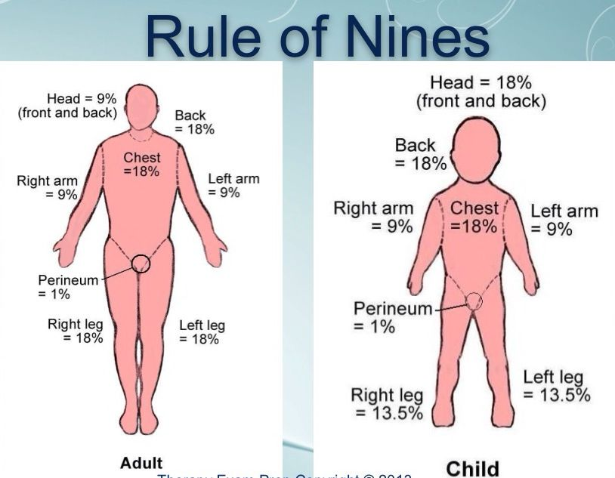

Slide 24
Lund and browder method
This method modifies the percentage of the body segments
according to age , and changes with growth and provides more
accurate estimation of burn size . So, it is commonly used in
children .

Slide 25
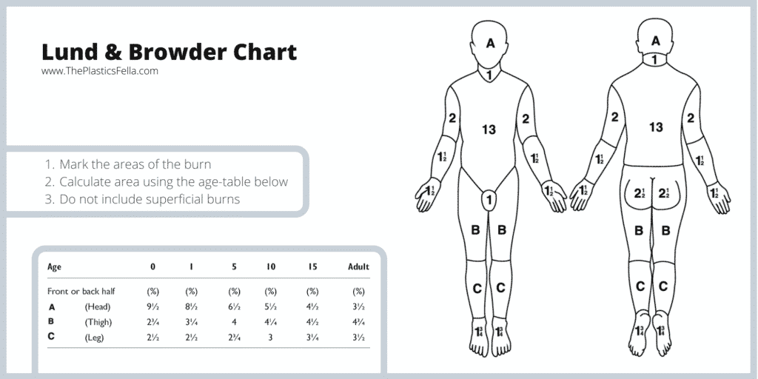

Slide 26
Palm method
In scattered burn, a palm method is used to estimate the burn .
The size of palm of the child’s hand ( from wrist to the
fingertips) is approximately 1% of total body surface area

Slide 27
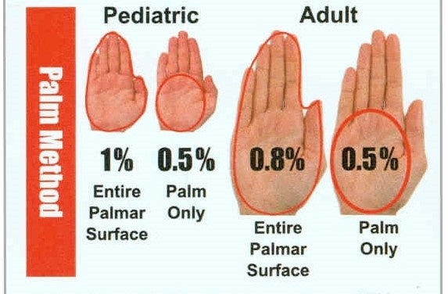

Slide 28
First aids measures
Before providing aid, ensure your safety and the safety of the victim. Remove the person from the source of the burn.
In case of open flame, the child should help to lie flat on the ground and roll on the floor.
Fire should be extinguished by pouring water.
Avoiding pouring of water over the burnt area, once the fire has been
extinguished, because it may be dangerous and lead to hypothermia,
hyponatremia( due to water absorption)

Slide 29
Remove all burnt clothing and bring the child into open air to get oxygen from atmosphere.
Remove all metallic ornaments.
The child should be wrapped in clean sheet to prevent heat loss.
Oral fluid or oral rehydration solution(ORS) should be given, if the child is thirsty and able to drink.
Blister should not be peeled off and should be allowed to spontaneous collapse.

Slide 30
Should not apply cotton or any household materials on burn area.
Oro-pharyngeal secretion should be removed to maintain patent airway.
The child should be turned to one side and respiration should be checked . If necessary, mouth to mouth breathing may be given.
Transfer to hospital should be arranged promptly for appropriate treatment and evaluation.

Slide 31
Treatment
Emergency Room Management of Major Burns
Although burn injuries that cover 25% or more of the body surface area
(BSA) are considered as major burns, any burn injury >10% should be
treated similarly. Majority of childhood burns are evaluated and resuscitated initially in the emergency department. Mortality in burn
injuries is to a large extent influenced by the initial care given in
the emergency department. Burn victims rarely die due to the burn, but
this can occur because of associated trauma, carbon monoxide (CO)
inhalation or airway compromise.

Slide 32
Initial Steps in the Management of a Major Burn
The burn injury must not distract from a sequential assessment
otherwise serious injuries can be missed easily. A methodical initial
approach to burn treatment is needed regardless of the etiology of the
burn and is essential to prevent mortality and includes:
Primary survey : investigations; pain management
secondary survey and focused history; and safe transfer to a specialized burns facility.

Slide 33
Primary Survey-ABCDE
The primary assessment, investigation, and treatment of a patient with
severe burns should be a continuous and integrated process. A modified
Pediatric Advanced Life Support is performed with particular emphasis
upon airway and breathing.

Slide 34
A-Airway with Cervical Spine Precautions
It is important to ensure and maintain an adequate airway, taking pre-
cautions for cervical spine stabilization, and to provide humidified
oxygen by mask or endotracheal intubation. It is mandatory to stabilize the cervical spine if the history and clinical examination are suggestive of injury .

Slide 35
B-Breathing
All burn victims should receive 100% oxygen through a nonrebreathing
mask . Respiratory system injury involving the lungs and chest can
occur due to an inhalation, aspiration, or direct thermal, electrical or
chemical injury. It is important not to rely on chest radiograph because
it is often normal at initial presentation.

Slide 36
Cardiac assessment in the burned child begins with the assessment of
peripheral, followed by the central pulses. The color of skin and
capillary refill in nonburned sites can be utilized, to assess for adequacy
of perfusion.
Vital signs may be difficult to obtain since burned extremities may
impede the ability to obtain a blood pressure reading by a
sphygmomanometer. In these situations arterial lines, particularly
femoral lines, can be placed to monitor continuous blood pressure
readings.

Slide 37
D-Disability
Neurological disability is assessed using alert, voice, pain, unresponsive
(AVPU) or Glasgow Coma Scale. Altered sensorium may be due to
hypoxia, hypovolemia, and sepsis if the patient
presents late to the emergency room.

Slide 38
E-Exposure
This involves a detailed examination of the patient after the initial
stabilization of airway, circulation, and disability. The patient should be
examined from head to toe, including the back for an accurate
estimate of the burnt area. Associated injuries should be identified.
Care should be taken to avoid hypothermia. Photographs should be
taken if possible without compromising patient care whenever possible.

Slide 39
Secondary Survey
This is done after primary survey and initial stabilization of the
patient and involves assessment of the burnt area and concomitant
injuries. A history should be elicited-the quickest way is to get an
AMPLE history which includes Allergy history, Medications, medical
Problems, Last meal time, and the Event (the mechanism of the burns
and treatment received so far).

Slide 40
Focused History in Burns
The most accurate description of events leading to the burn injury can be taken first hand from those who accompany the child in the emergency room. It should include:
Type of agent that caused the burn (flame, liquid, electrical, chemical, etc.)
If there was any explosion
Duration of exposure to agent.
Time of injury.

Slide 41
Fluid Resuscitation in Major Burns
Indications for Intravenous Fluids
All burns of >10% BSA require intravenous fluid resuscitation to maintain adequate tissue perfusion.
All inhalational injuries whatever the BSA require venous access to control fluid intake.

Slide 42
Calculation of Intravenous Fluids in Major Burns
Fluid resuscitation in the first 24 hours is based on the modified Parkland formula.
Parkland formula: Total fluid requirement in 24 hours (given as Ringer lactate infusion) = 3 mL x total burn surface area (%) x body weight (kg).
50% given in first 8 hours, and
50% given in next 16 hours

Slide 43
Children should receive maintenance fluid in addition, at hourly rate of:
4 – 2 – 1 Rule
4 mL/kg for first 10 kg of body weight ( 0 – 10 kg )
2 mL/kg for next 10 kg of body weight plus ( 10 – 20 kg )
1 mL/kg for each kg after 20 kg of body weight. ( > 20 kg )
End point: Urine output of 1.0 mL/kg/h in children.
The starting point for resuscitation is the time of injury and not the time
of admission, hence any fluid given before admission should be
deducted from the calculated requirement.

Slide 44
OTHERS
Prevent hypothermia.
Insert Foleys catheter to facilitate urination and for accurate measurement of the urine output is mandatory for all children more than 10% burn.
Accurate monitoring of intake/output; electrolytes, vital signs and other general condition
N/G tube in continuous drainage if abdominal area affected of abdominal distension present

Slide 45
Supportive Analgesics may be given to relieve pain.
Tetanus immune prophylaxis is given depending on the immune status of the child.
Dressing of the wound.
Local care: Apply silver sulfadiazine ointment in thin layer over burns. Initial debridement should be limited to removing the loose hanging skin. Blisters are debrided only if they rupture spontaneously or become infected. Application of silver sulfadiazine should be stopped when epithelialization starts.

Slide 46
Administer Antibiotics: to prevent or treat infection.
Monitor for Complications: such as infection or scarring.
Provide Emotional Support: provide emotional support to both the child and their family, as burns can be traumatic and distressing.
Rehabilitation care

Slide 47
Prevention
Advice the parents to check the bath water temperature before pouring water .
Supervise small children at all times in the bathtub so they cannot turn on the hot water tap or pour hot water.
Keep hot liquids, such as coffee or tea out of reach of children.
Cover electrical outlets with safety covers to prevent burns from electrical shocks.

Slide 48
Keep the gas and stove turned off when not in use.
Avoiding the firework and kitchen work carrying/holding the young child on lap.
Teach children about fire safety, including not playing with matches or lighters, and how to respond in case of a fire.
Install smoke alarms throughout the home and check them regularly to ensure they are working properly.

Slide 49
Complications
Early
Shock (Hypovolemic, Neurogenic or Septic)
Fluid and electrolyte disturbances
Respiratory distress
GI bleeding due to Curling’s ulcer
Infection
Renal failure
Urinary tract infection

Slide 50
Late
Anemia
Malnutrition
Growth retardation
Chronic ulcer with malignancy

Slide 51


Slide 52
Summary
What is aspiration and its preventive measures?
2. What is burn and the causes of burn in preschool?
3. What are the first aid measures of burn?

Slide 53
Home Assignment
Write short notes on aspiration?
2. Explain the treatment of burn?

Slide 54
Plan for next class
We will discuss about parasitic infestation on next class.

Slide 55
References
Ghai, O.P (2019), Ghai Essentials Pediatrics (9th edition) , Page no: 704, 705
M. Mankesari (2022), Comprehensive Texxtbook of Child Health Nursing, 1st edition, Samikshya publication, Page no:637,638

Slide 56
S. Tumla, Essential Child Health Nursing (2nd edition), Medhavi Publication, Page No: 622,623,624
S. Bharati, Essential Textbook of Nursing Care of Children, Samiksha Publication, Page No: 336
D. Parul (2018), Pediatric Nursing (4th edition), Page No: 386

Slide 57


